Slide 1
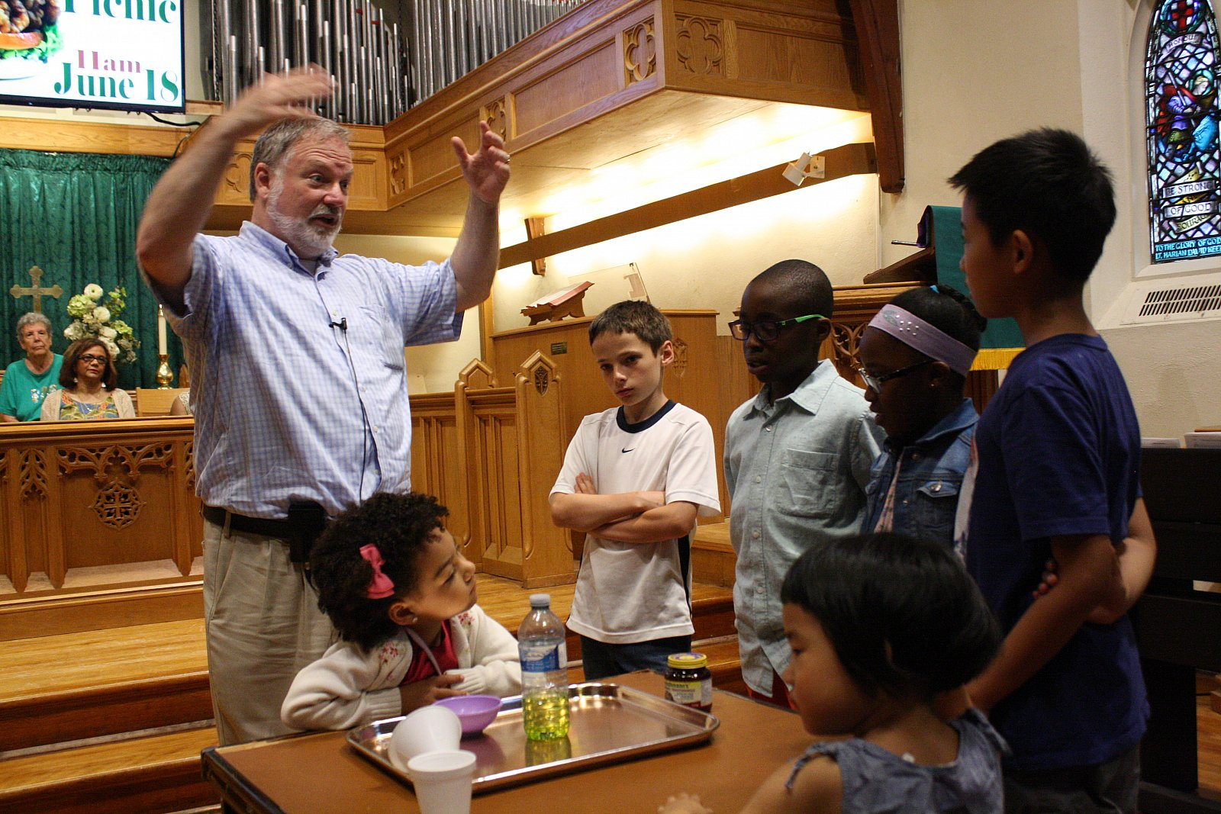
Sunday July 23, 2017

Slide 2
Welcome

Slide 3
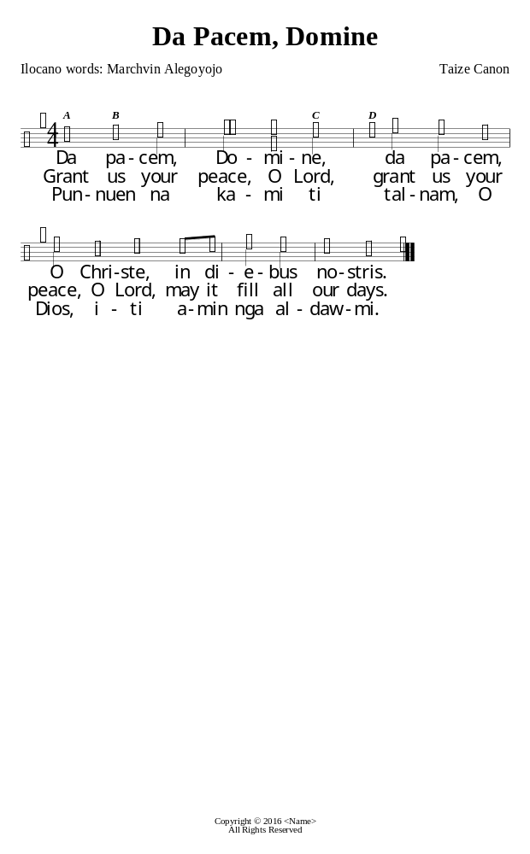
Reprinted under OneLicense.net #A-724406

Slide 4
Call To Worship

Slide 5

O God of Bethel
VU-650
Words: Philip Doddridge, John Logan. Music: Adapted from Johann Michael Haydn.
Public Domain

Slide 6
1 O God of Bethel, by whose hand your people still are fed, who through this earthly pilgrimage have all your servants led:

Slide 7
2 our vows, our prayers, we now present before your throne of grace.
God of past ages, be the God of each succeeding race.

Slide 8
3 Through each perplexing path of life our wandering footsteps guide; give us each day our daily bread, and shelter fit provide.

Slide 9
4 O spread your covering wings around, till all our wanderings cease, and at our God's beloved abode our souls arrive in peace.

Slide 10
Opening Prayer
O God who appeared to Jacob at Bethel
And sent a ladder to connect Earth and Heaven,
Sometimes we too long for such an obvious sign
Of your presence among us.

Slide 11
We too want a dream like that.
We too want a sign like that.
We too sometimes find the path of life “perplexing,”

Slide 12
And we wonder where you are,
And how to make the most meaning out of life,
And how we know when we’re succeeding,
And what it truly means to be faithful.

Slide 13
Help us to pay attention to the signs that you do give us.
Help us to live in the light of the grace we receive.
Help us to trust in the compassion you call out of us,
Rather than simply rely on our own wits
Or strength, or cleverness.

Slide 14
Give us each day our daily bread,
And spread your covering wings around us
Until, indeed, all our wanderings cease.

Slide 15
(time for silent prayer
and confession)

Slide 16
Assurance of Pardon

Slide 17
Reprinted under OneLicense.net #A-724406

Slide 18
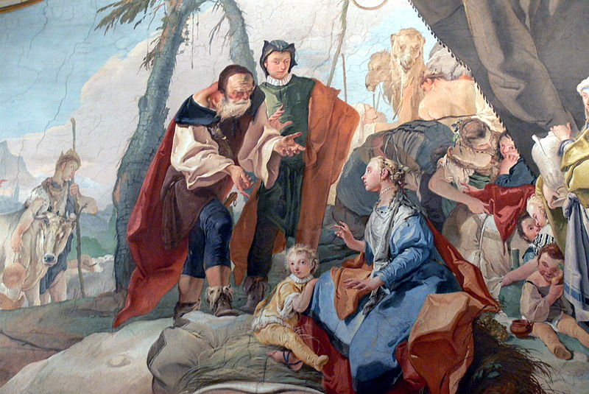
First Reading:
Genesis 29: 15-28
Permission is granted to copy, distribute and/or modify this document under the terms of the GNU Free Documentation License, Version 1.2 or any later version published by the Free Software Foundation; with no Invariant Sections, no Front-Cover Texts, and no Back-Cover Texts. A copy of the license is included in the section entitled GNU Free Documentation License.
https://commons.wikimedia.org/wiki/File:Udine_Palazzo_Patriarcale_-_Laban_1.jpg

Slide 19
Reprinted under OneLicense.net #A-724406

Slide 20
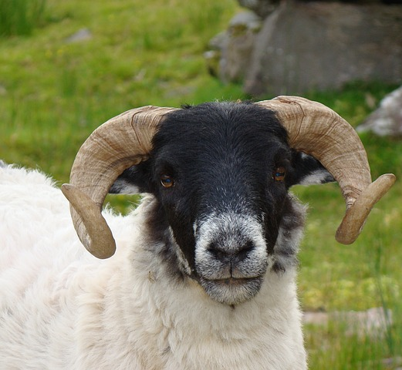
Second Reading:
Genesis
30: 25-43

Slide 21
Reprinted under OneLicense.net #A-724406

Slide 22
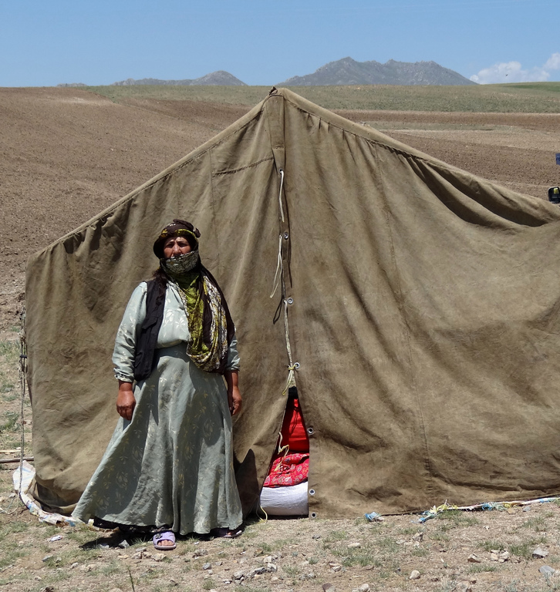
Sermon
“Stories of Promise:
Rachel and Leah”
https://www.flickr.com/photos/adam_jones/7421277762/sizes/l

Slide 23
Reprinted under OneLicense.net #A-724406

Slide 24

I Was There to Hear
Your Borning Cry
VU-644
Words, Music: © 1985 John Ylvisaker, P.O. Box 321, Waverly, IA 50667, USA.
"Used with permission" LicenSing #624991

Slide 25
1 I was there to hear your borning cry,
I'll be there when you are old.
I rejoiced the day you were baptized, to see your life unfold.

Slide 26
2I was there when you were but a child, with a faith to suit you well; in a blaze of light you wandered off to find where demons dwell.

Slide 27
3 When you heard the wonder of the word,
I was there to cheer you on; you were raised to praise the living Lord, to whom you now belong.

Slide 28
4 If you find someone to share your time and you join your hearts as one,
I'll be there to make your verses rhyme from dusk till rising sun.

Slide 29
5 In the middle ages of your life, not too old, no longer young.
I'll be there to guide you through the night, complete what I've begun.

Slide 30
6 When the evening gently closes in and you shut your weary eyes,
I'll be there as I have always been with just one more surprise.

Slide 31
7 I was there to hear your borning cry,
I'll be there when you are old.
I rejoiced the day you were baptized, to see your life unfold.

Slide 32
Our Works and Concerns

Slide 33


Slide 34
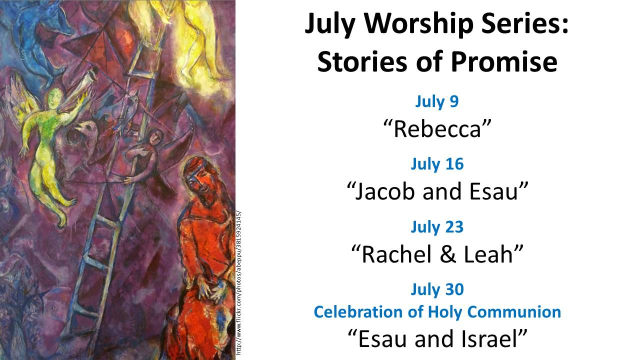

Slide 35
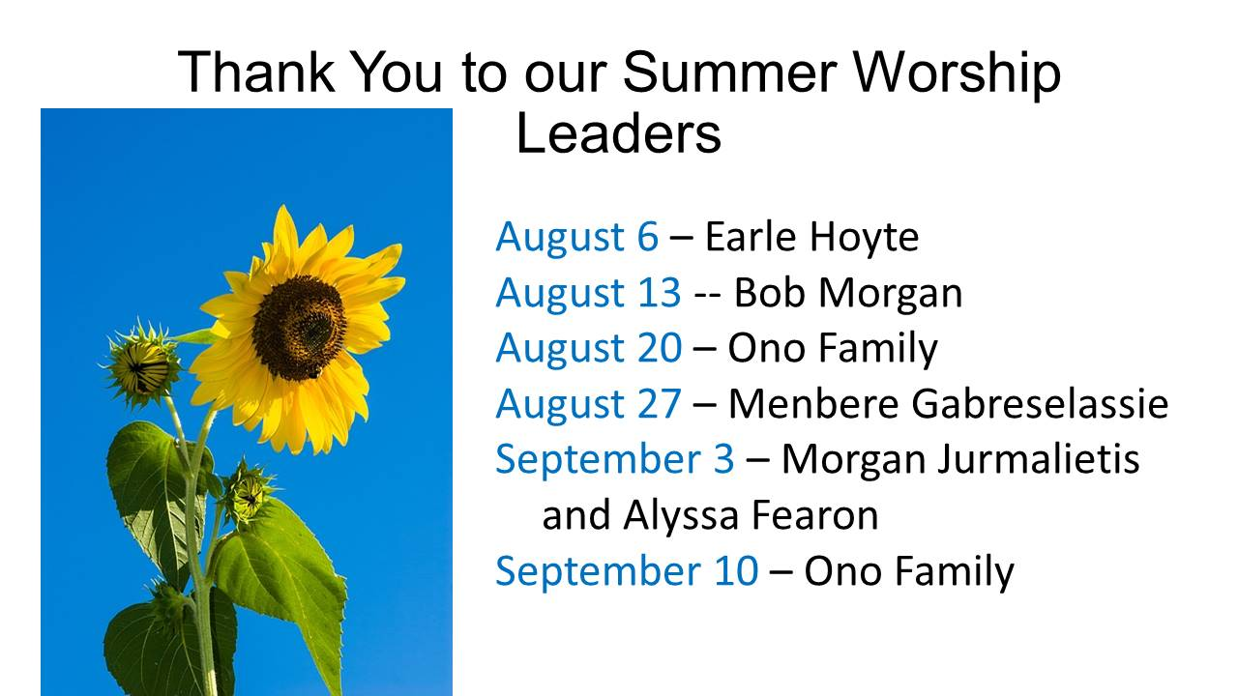

Slide 36


Slide 37


Slide 38
Offering and Offertory Music

Slide 39

O God, Send out Your Spirit (refrain)
O God, send out your Spirit;
Renew the face of the earth.
O God, send out you Spirit;
Renew the face of the earth.
MV-25
Words (refrain): The International Commission on English in the Liturgy (ICEL) Music and verse text copyright © 1996 Jesse Manibusan. Published by spiritandsong.com ®. Used with permission. Refrain text copyright © ICEL. LicenSingOnline "Used with permission" LicenSing #624991

Slide 40
Offertory Prayer

Slide 41
Prayers for the People

Slide 42
The Lord's Prayer
Our Father, who art in heaven hallowed be thy name.
Thy Kingdom come, thy will be done on Earth as it is in Heaven.

Slide 43
Give us this day our daily bread and forgive us our trespasses, as we forgive those who trespass against us.
And lead us not into temptation, but deliver us from evil

Slide 44
for Thine is the Kingdom and the Power and the Glory for ever and ever.
Amen

Slide 45

  Guide Me, O Thou Great Jehovah
VU-651
Words: Welsh, William Williams. English Translation: Peter Williams and William Williams. French Translation: Flossette du Pasquier. Music: John Hughes. Public Domain

Slide 46
1 Guide me, O thou great Jehovah, pilgrim through this barren land.
I am weak, but thou art mighty, hold me with thy powerful hand.

Slide 47
Bread of heaven, bread of heaven, feed me till I want no more, feed me till I want no more.

Slide 48
2 Open now the crystal fountain, whence the healing stream doth flow; let the fire and cloudy pillar lead me all my journey through.

Slide 49
Strong deliverer, strong deliverer, be thou still my strength and shield, be thou still my strength and shield.

Slide 50
3 When I tread the verge of Jordan, bid my anxious fears subside; death of death, and hell's destruction, land me safe on Canaan's side:

Slide 51
songs of praises, songs of praises
I will ever give to thee,
I will ever give to thee.

Slide 52
Dismissal & Blessing

Slide 53

May the love of the Lord rest upon your soul.
May God’s love dwell in you, throughout every day.
May God’s countenance shine upon you and be gracious to you.
May God’s Spirit be upon you as you leave this place.
(MV-218)
Words: Maria Ling Poh Choo, Singapore
Music: Swee Hong Lim, Singapore Words and music copyright © 2000 General Board of Global Ministries, GBGMusik,
475 Riverside Dr., New York, NY 10115. OneLicense.net

Slide 54
Sunday July 23, 2017

